Slide 1
Kernel Methods

Slide 2
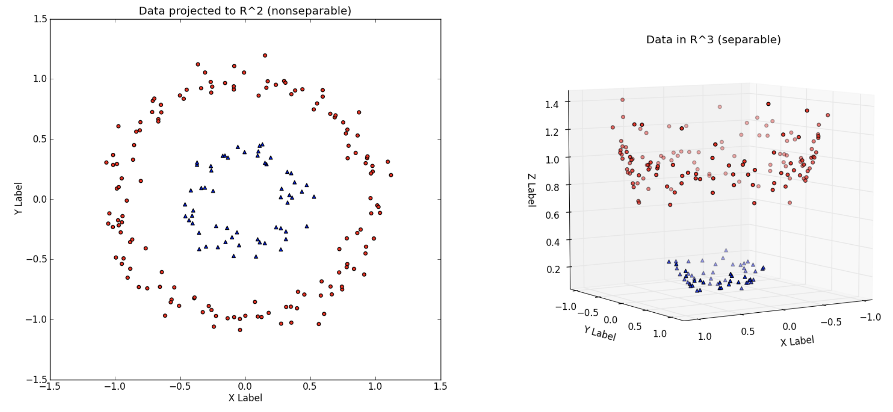

Slide 3
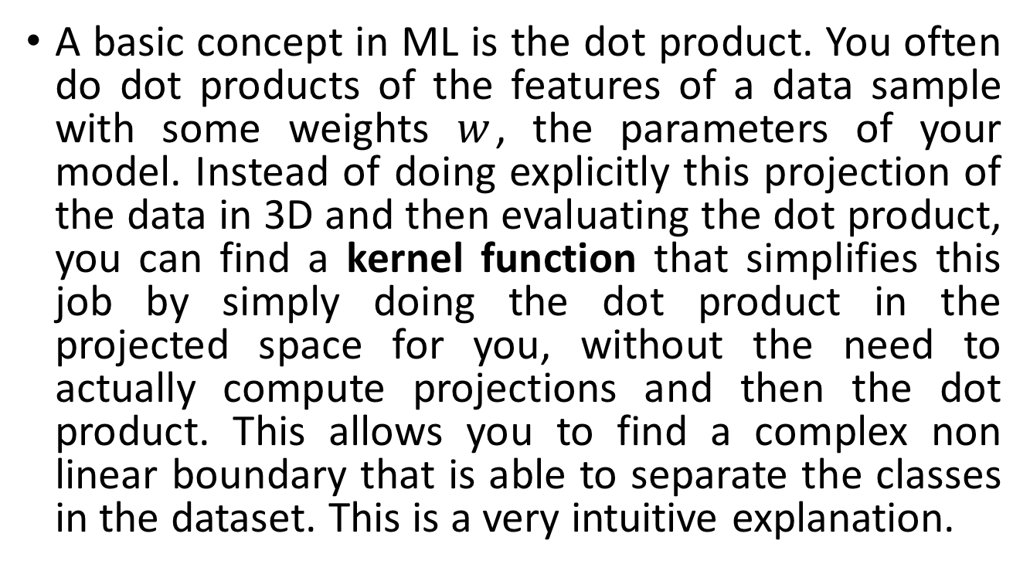
A basic concept in ML is the dot product. You often do dot products of the features of a data sample with some weights $w$, the parameters of your model. Instead of doing explicitly this projection of the data in 3D and then evaluating the dot product, you can find a kernel function that simplifies this job by simply doing the dot product in the projected space for you, without the need to actually compute projections and then the dot product. This allows you to find a complex non linear boundary that is able to separate the classes in the dataset. This is a very intuitive explanation.

Slide 4
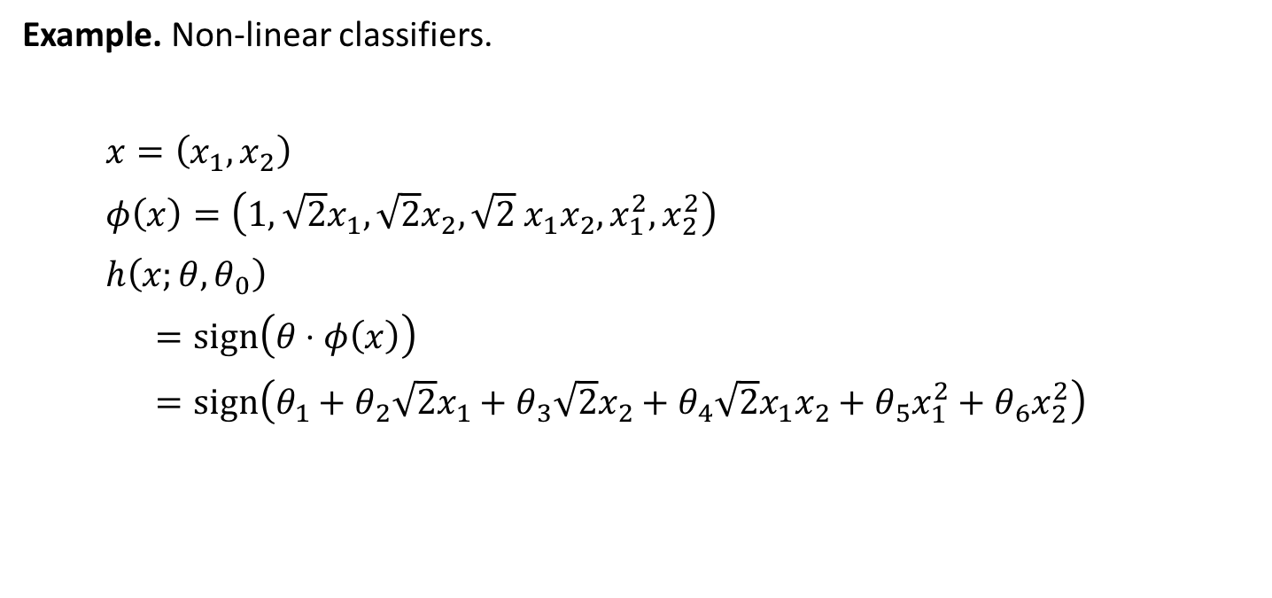
Feature Mapping
Example. Non-linear classifiers.
$x=\left(x_{1},x_{2}\right)$
$φ\left(x\right)=\left(1, \sqrt{2}x_{1},{\sqrt{2}x}_{2},\sqrt{2} x_{1}x_{2}, x_{1}^{2}, x_{2}^{2}\right)$
$h\left(x;θ,θ_{0}\right)$
$=sign\left(θ⋅φ\left(x\right)\right)$
$=sign\left(θ_{1}+θ_{2}\sqrt{2}x_{1}+θ_{3}\sqrt{2}x_{2}+θ_{4}\sqrt{2}x_{1}x_{2}+θ_{5}x_{1}^{2}+θ_{6}x_{2}^{2}\right)$

Slide 5
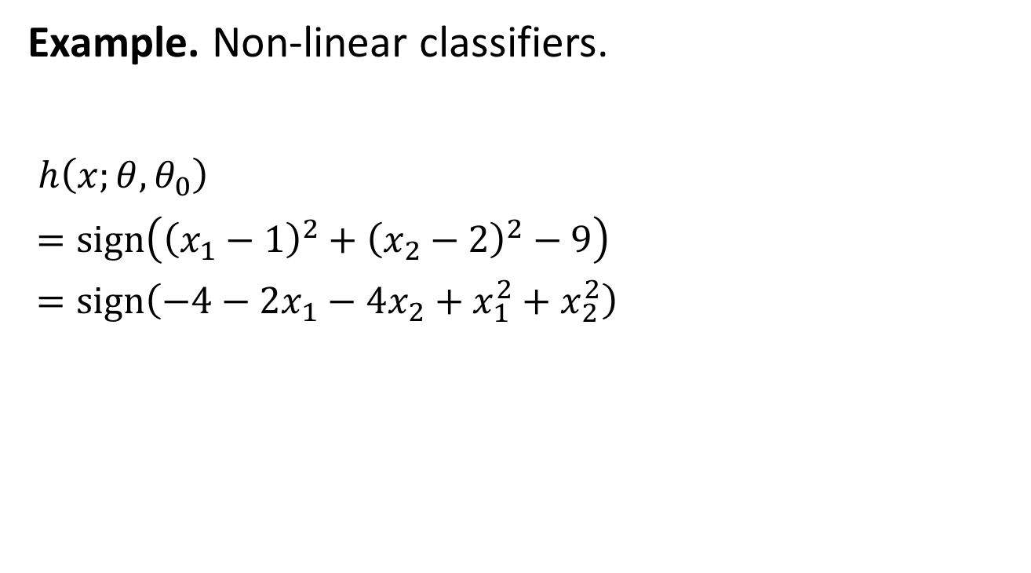
Feature Mapping
Example. Non-linear classifiers.
$h\left(x;θ,θ_{0}\right)$
$=sign\left({\left(x_{1}−1\right)}^{2}+{\left(x_{2}−2\right)}^{2}−9\right)$
$=sign\left(−4−2x_{1}−4x_{2}+x_{1}^{2}+x_{2}^{2}\right)$
+
+
–
–
–
–
+
+

Slide 6
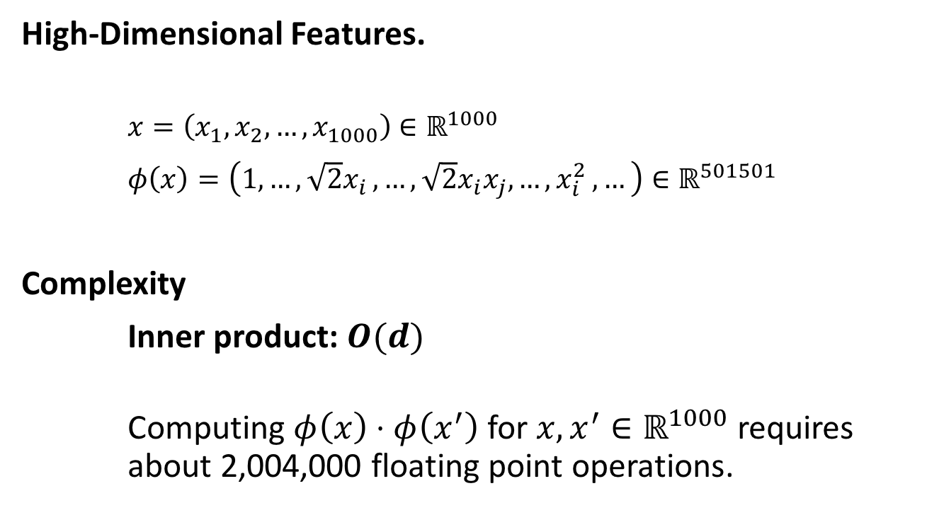
Challenges
High-Dimensional Features.
$x=\left(x_{1},x_{2},…, x_{1000}\right)∈ℝ^{1000}$
$φ\left(x\right)=\left(1,{…,\sqrt{2}x}_{i},…, \sqrt{2}x_{i}x_{j}, …{,x}_{i}^{2}, …\right)∈ℝ^{501501}$
Complexity
Inner product: $O(d)$
Computing $φ\left(x\right)⋅φ\left(x^{′}\right)$ for $x,x^{′}∈ℝ^{1000}$ requires about 2,004,000 floating point operations.

Slide 7
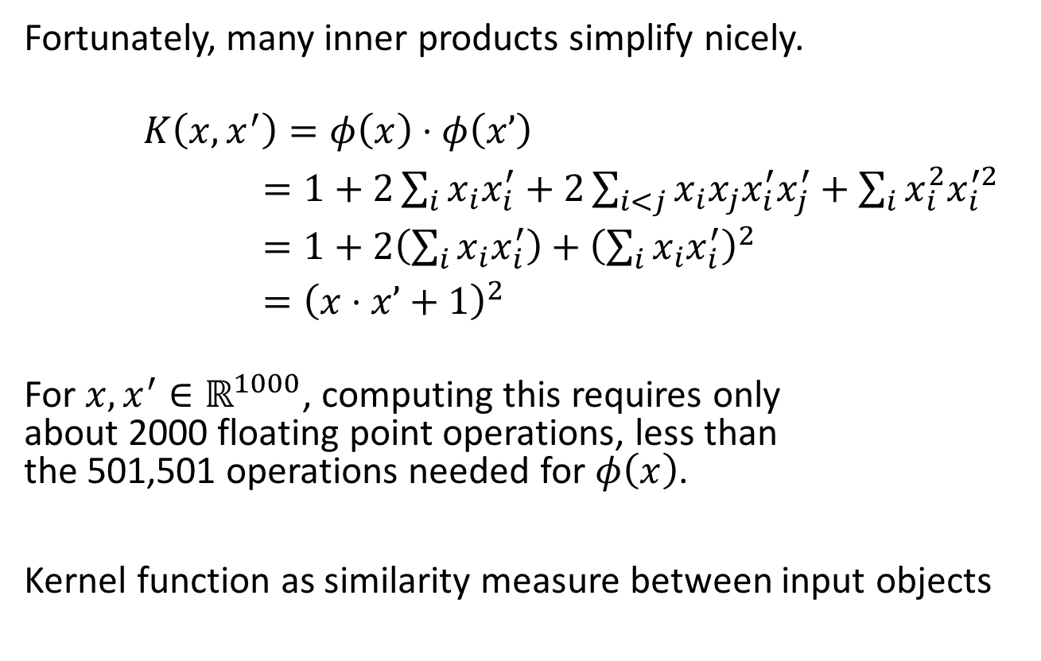
Kernel Functions
Fortunately, many inner products simplify nicely.
$K\left(x,x^{′}\right)=φ\left(x\right)⋅φ\left(x’\right)$
$=1+2\sum_{i}{x_{i}x_{i}^{′}}+2\sum_{i<j}{x_{i}x_{j}x_{i}^{′}x_{j}^{′}}+\sum_{i}{x_{i}^{2}x_{i}^{′2}}$
$=1+2\left(\sum_{i}{x_{i}x_{i}^{′}}\right)+{\left(\sum_{i}{x_{i}x_{i}^{′}}\right)}^{2}$
$={\left(x⋅x’+1\right)}^{2}$
For $x,x^{′}∈ℝ^{1000}$, computing this requires only about 2000 floating point operations, less than the 501,501 operations needed for $φ\left(x\right)$.
Kernel function as similarity measure between input objects

Slide 8
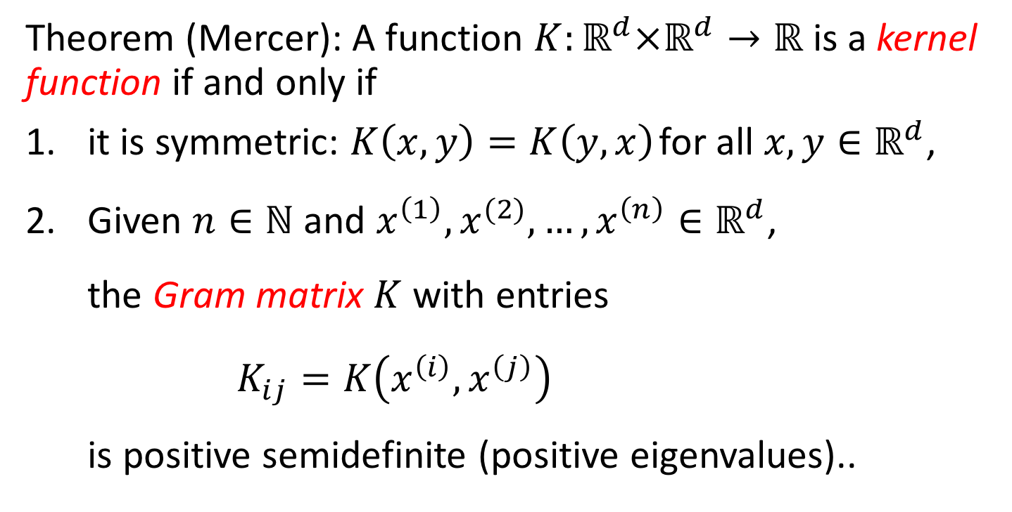
Kernel Definition
Theorem (Mercer): A function $K:ℝ^{d}×ℝ^{d}→ℝ$ is a kernel function if and only if
it is symmetric: $K\left(x,y\right)=K\left(y,x\right)$ for all $x,y∈ℝ^{d}$,
Given $n∈ℕ$ and $x^{\left(1\right)},x^{(2)}, …,x^{\left(n\right)}∈ℝ^{d}$, the Gram matrix $K$ with entries $K_{ij}=K\left(x^{\left(i\right)},x^{\left(j\right)}\right)$ is positive semidefinite (positive eigenvalues)..

Slide 9
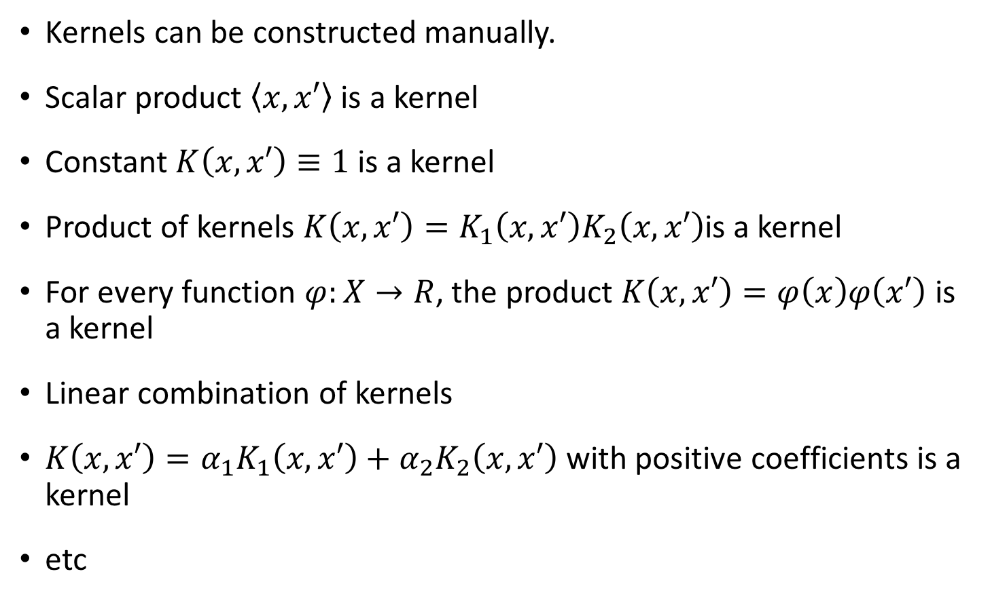
Kernel Properties
Kernels can be constructed manually.
Scalar product $\left\langle x,x′\right\rangle$is a kernel
Constant $K\left(x,x′\right)≡1$ is a kernel
Product of kernels $K\left(x,x′\right)=K_{1}\left(x,x′\right)K_{2}\left(x,x′\right)$is a kernel
For every function $φ:X→R$, the product $K\left(x,x′\right)=φ\left(x\right)φ\left(x′\right)$ is a kernel
Linear combination of kernels
$K\left(x,x′\right)=α_{1}K_{1}\left(x,x′\right)+{α_{2}K}_{2}\left(x,x′\right)$ with positive coefficients is a kernel
etc

Slide 10
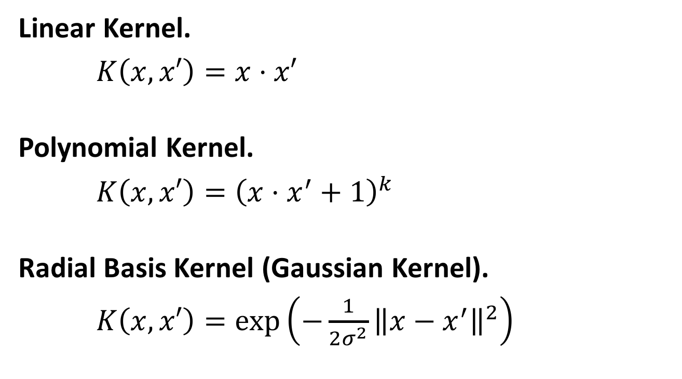
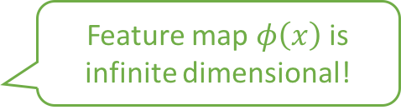
Examples
Linear Kernel.
$K\left(x,x′\right)=x⋅x′$
Polynomial Kernel.
$K\left(x,x′\right)={\left(x⋅x^{′}+1\right)}^{k}$
Radial Basis Kernel (Gaussian Kernel).
$K\left(x,x′\right)=\exp\left(−\frac{1}{2σ^{2}}{\left\|x−x^{′}\right\|}^{2}\right)$
Feature map $φ\left(x\right)$ is infinite dimensional!

Slide 11
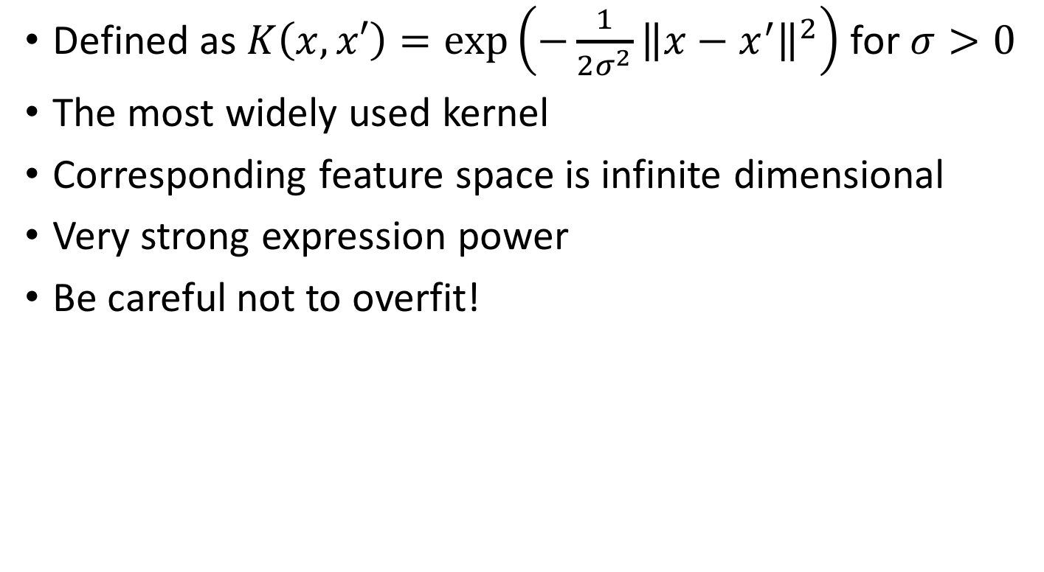
The Gaussian Kernel Online material https://en.wikipedia.org/wiki/Radial_basis_function_kernel
Defined as $K\left(x,x′\right)=\exp\left(−\frac{1}{2σ^{2}}{\left\|x−x^{′}\right\|}^{2}\right)$ for $σ>0$
The most widely used kernel
Corresponding feature space is infinite dimensional
Very strong expression power
Be careful not to overfit!

Slide 12
Kernel Trick in SVM

Slide 13
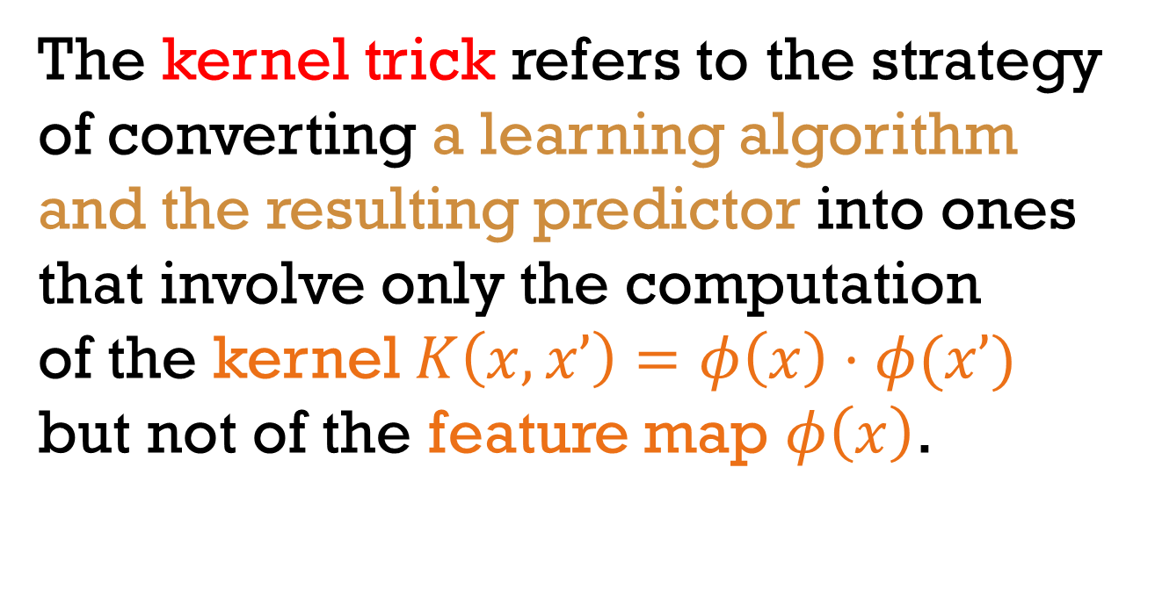
Kernel Trick
The kernel trick refers to the strategy of converting a learning algorithm and the resulting predictor into ones that involve only the computation of the kernel $K\left(x,x’\right)=φ\left(x\right)⋅φ(x’)$ but not of the feature map $φ\left(x\right)$.

Slide 14
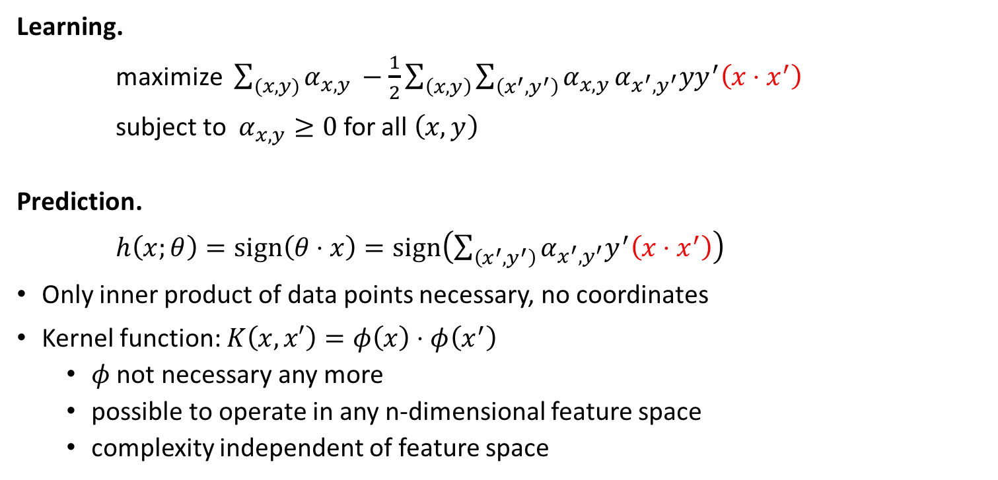
Support Vector Machines
Learning.
maximize $\sum_{(x,y)}{α_{x,y }}−\frac{1}{2}\sum_{\left(x,y\right)}{\sum_{\left(x^{′},y^{′}\right)}{α_{x,y}}}α_{x^{′},y^{′}}yy^{′}\left(x⋅x^{′}\right)$
subject to $α_{x,y}≥0$ for all $\left(x,y\right)$
Prediction.
$h\left(x;θ\right)=sign\left(θ⋅x\right)=sign\left(\sum_{\left(x^{′},y^{′}\right)}{α_{x^{′},y^{′}}y^{′}\left(x⋅x^{′}\right)}\right)$
Only inner product of data points necessary, no coordinates
Kernel function: $K\left(x,x′\right)=φ\left(x\right)⋅φ\left(x^{′}\right)$
$φ$ not necessary any more
possible to operate in any n-dimensional feature space
complexity independent of feature space

Slide 15
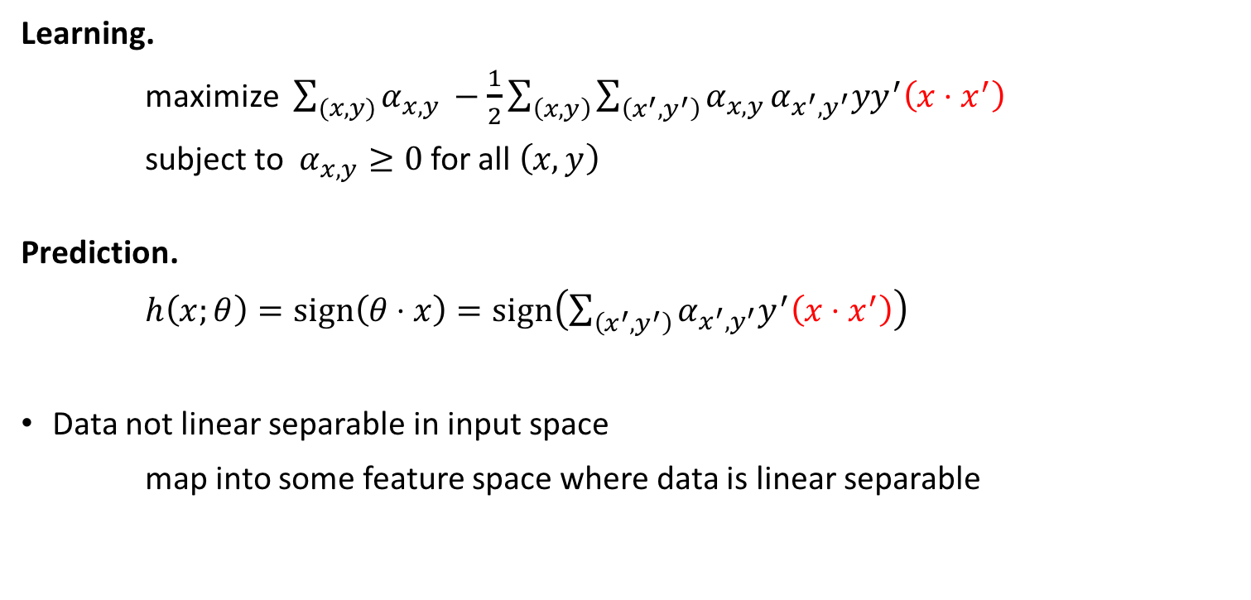
Support Vector Machines
Learning.
maximize $\sum_{(x,y)}{α_{x,y }}−\frac{1}{2}\sum_{\left(x,y\right)}{\sum_{\left(x^{′},y^{′}\right)}{α_{x,y}}}α_{x^{′},y^{′}}yy^{′}\left(x⋅x^{′}\right)$
subject to $α_{x,y}≥0$ for all $\left(x,y\right)$
Prediction.
$h\left(x;θ\right)=sign\left(θ⋅x\right)=sign\left(\sum_{\left(x^{′},y^{′}\right)}{α_{x^{′},y^{′}}y^{′}\left(x⋅x^{′}\right)}\right)$
Data not linear separable in input space
map into some feature space where data is linear separable

Slide 16
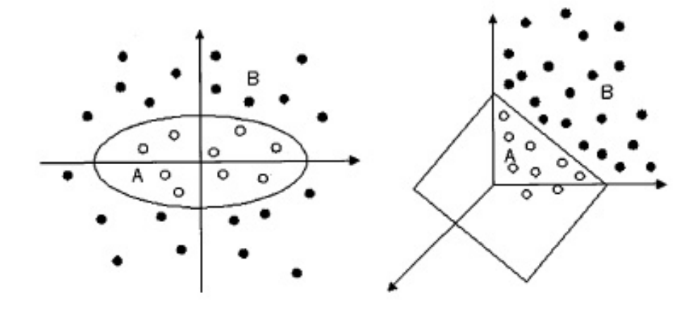
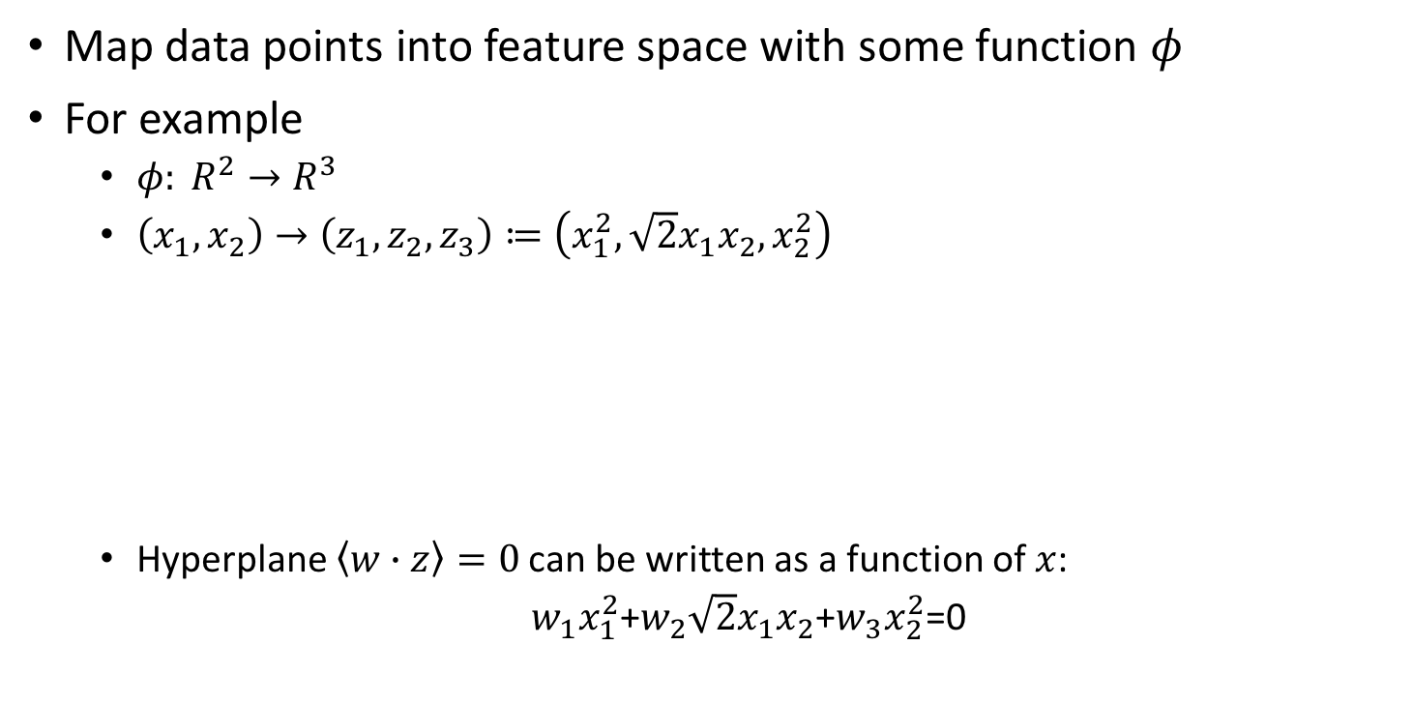
Mapping Example
Map data points into feature space with some function $φ$
For example
$φ: R^{2}→R^{3}$
$\left(x_{1}, x_{2}\right)→\left(z_{1}, z_{2},z_{3}\right)≔\left(x_{1}^{2}, \sqrt{2}x_{1}x_{2},x_{2}^{2}\right)$
Hyperplane $\left\langle w∙z\right\rangle =0$ can be written as a function of $x$:
$w_{1}x_{1}^{2}$+$w_{2}\sqrt{2}x_{1}x_{2}$+$w_{3}x_{2}^{2}$=0

Slide 17
Another Mapping Example

Slide 18
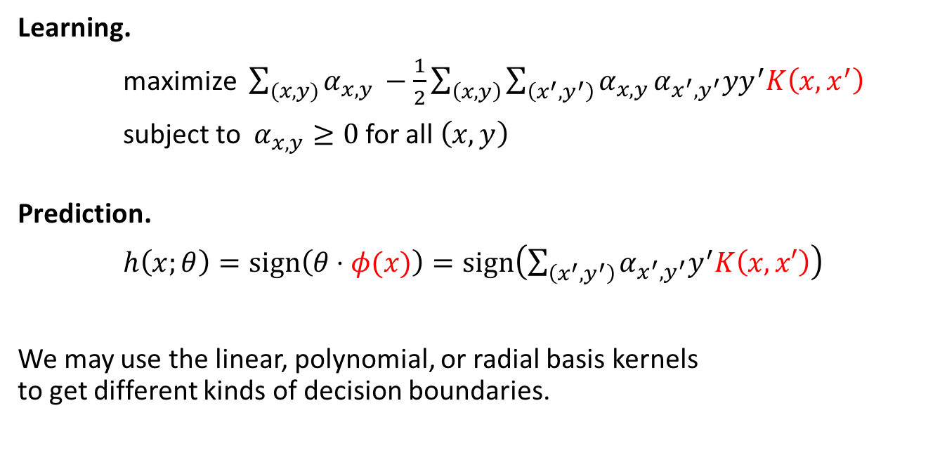
Kernel Support Vector Machines
Learning.
maximize $\sum_{(x,y)}{α_{x,y }}−\frac{1}{2}\sum_{\left(x,y\right)}{\sum_{\left(x^{′},y^{′}\right)}{α_{x,y}}}α_{x^{′},y^{′}}yy^{′}K\left(x,x^{′}\right)$
subject to $α_{x,y}≥0$ for all $\left(x,y\right)$
Prediction.
$h\left(x;θ\right)=sign\left(θ⋅φ(x)\right)=sign\left(\sum_{\left(x^{′},y^{′}\right)}{α_{x^{′},y^{′}}y^{′}K\left(x,x′\right)}\right)$
We may use the linear, polynomial, or radial basis kernels to get different kinds of decision boundaries.

Slide 19
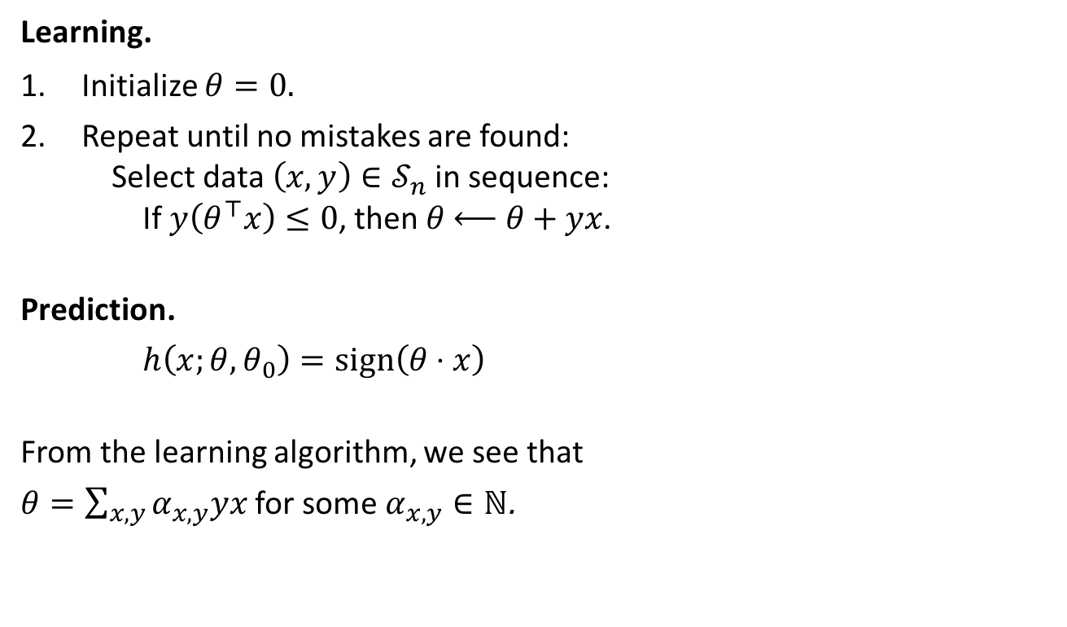
Perceptron
Learning.
Initialize $θ=0.$
Repeat until no mistakes are found: Select data $\left(x,y\right)∈𝒮_{n}$ in sequence: If $y\left(θ^{⊤}x\right)≤0$, then $θ \underset{←}{ } θ+yx$.
Prediction.
$h\left(x;θ,θ_{0}\right)=sign\left(θ⋅x\right)$
From the learning algorithm, we see that
$θ=\sum_{x,y}{α_{x,y}yx}$ for some $α_{x,y}∈ℕ$.

Slide 20
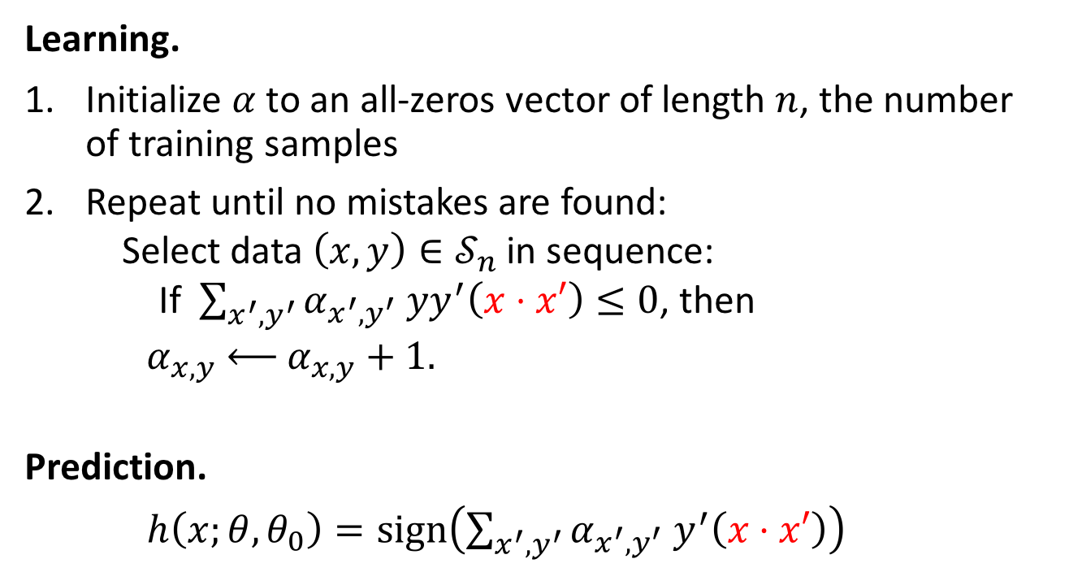
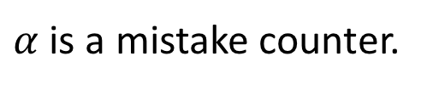
Perceptron online tutorial: https://en.wikipedia.org/wiki/Kernel_perceptron
Learning.
Initialize $α$ to an all-zeros vector of length $n$, the number of training samples
Repeat until no mistakes are found: Select data $\left(x,y\right)∈𝒮_{n}$ in sequence: If $\sum_{x^{′},y^{′}}{α_{x^{′},y^{′}} yy^{′}\left(x⋅x′\right)}≤0$, then $α_{x,y} \underset{←}{ } α_{x,y}+1.$
Prediction.
$h\left(x;θ,θ_{0}\right)=sign\left(\sum_{x^{′},y^{′}}{α_{x^{′},y^{′}} y^{′}\left(x⋅x′\right)}\right)$
$α$ is a mistake counter.

Slide 21
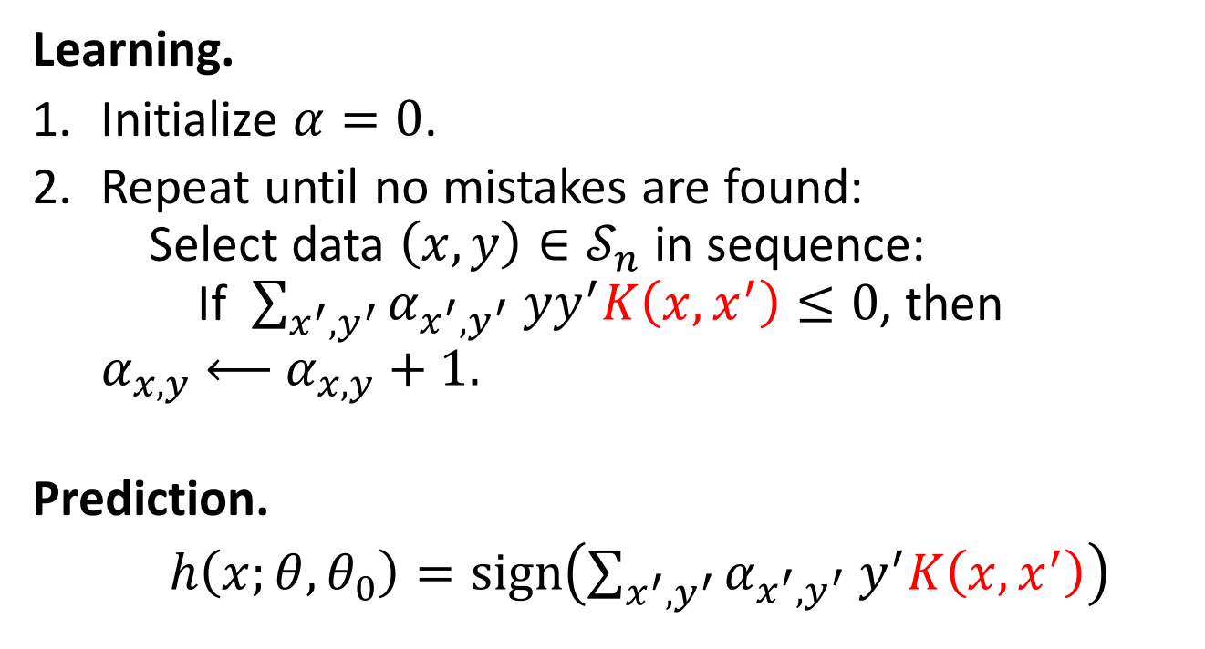
Kernel Perceptron
Learning.
Initialize $α=0$.
Repeat until no mistakes are found: Select data $\left(x,y\right)∈𝒮_{n}$ in sequence: If $\sum_{x^{′},y^{′}}{α_{x^{′},y^{′}} yy^{′}K\left(x,x^{′}\right)}≤0$, then $α_{x,y} \underset{←}{ } α_{x,y}+1.$
Prediction.
$h\left(x;θ,θ_{0}\right)=sign\left(\sum_{x^{′},y^{′}}{α_{x^{′},y^{′}} y^{′}K\left(x,x^{′}\right)}\right)$

Slide 22
Summary
Kernel Functions
Feature Maps
Inner Products
Polynomial Kernel
Radial Basis Kernel
Kernel Trick
Support Vector Machines
Perceptron

Slide 23
Convolutional Neural Networks
Online tutorial: http://cs231n.github.io/convolutional-networks/

Slide 24


Consider learning an image:
Some patterns are much smaller than the whole image
That’s why we use relatively small convolutional filters
“beak” detector

Slide 25

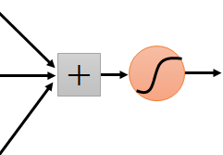
Same pattern appears in different places: They can be compressed! What about training a lot of such “small” detectors and each detector must “move around”.
“upper-left beak” detector
They can be compressed
to the same parameters.
“middle beak” detector

Slide 26
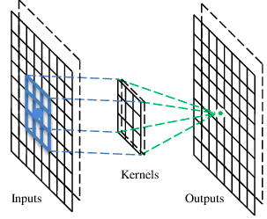
A convolutional layer
A CNN is a neural network with some convolutional layers
(and some other layers). A convolutional layer has a number
of filters that does convolutional operation.
Beak detector
A filter

Slide 27
Convolution
These are the network parameters to be learned.
1 | -1 | -1
-1 | 1 | -1
-1 | -1 | 1
1 | 0 | 0 | 0 | 0 | 1
0 | 1 | 0 | 0 | 1 | 0
0 | 0 | 1 | 1 | 0 | 0
1 | 0 | 0 | 0 | 1 | 0
0 | 1 | 0 | 0 | 1 | 0
0 | 0 | 1 | 0 | 1 | 0
Filter 1
-1 | 1 | -1
-1 | 1 | -1
-1 | 1 | -1
Filter 2
……
6 x 6 image
Each filter detects a small pattern (3 x 3).

Slide 28
Convolution
1 | -1 | -1
-1 | 1 | -1
-1 | -1 | 1
Filter 1
stride=1
1 | 0 | 0 | 0 | 0 | 1
0 | 1 | 0 | 0 | 1 | 0
0 | 0 | 1 | 1 | 0 | 0
1 | 0 | 0 | 0 | 1 | 0
0 | 1 | 0 | 0 | 1 | 0
0 | 0 | 1 | 0 | 1 | 0
Dot
product
3
-1
6 x 6 image

Slide 29
Convolution
1 | -1 | -1
-1 | 1 | -1
-1 | -1 | 1
Filter 1
If stride=2
1 | 0 | 0 | 0 | 0 | 1
0 | 1 | 0 | 0 | 1 | 0
0 | 0 | 1 | 1 | 0 | 0
1 | 0 | 0 | 0 | 1 | 0
0 | 1 | 0 | 0 | 1 | 0
0 | 0 | 1 | 0 | 1 | 0
3
-3
6 x 6 image

Slide 30
Convolution
1 | -1 | -1
-1 | 1 | -1
-1 | -1 | 1
Filter 1
stride=1
1 | 0 | 0 | 0 | 0 | 1
0 | 1 | 0 | 0 | 1 | 0
0 | 0 | 1 | 1 | 0 | 0
1 | 0 | 0 | 0 | 1 | 0
0 | 1 | 0 | 0 | 1 | 0
0 | 0 | 1 | 0 | 1 | 0
3
-1
-3
-1
-3
1
0
-3
-3
-3
0
1
3
-2
-2
-1
6 x 6 image

Slide 31
Convolution
-1 | 1 | -1
-1 | 1 | -1
-1 | 1 | -1
Filter 2
stride=1
Repeat this for each filter
1 | 0 | 0 | 0 | 0 | 1
0 | 1 | 0 | 0 | 1 | 0
0 | 0 | 1 | 1 | 0 | 0
1 | 0 | 0 | 0 | 1 | 0
0 | 1 | 0 | 0 | 1 | 0
0 | 0 | 1 | 0 | 1 | 0
3
-1
-3
-1
-1
-1
-1
-1
-3
1
0
-3
-1
-1
-2
1
Feature
Map
-3
-3
0
1
-1
-1
-2
1
3
-2
-2
-1
6 x 6 image
-1
0
-4
3
Two 4 x 4 images
Forming 2 x 4 x 4 matrix

Slide 32
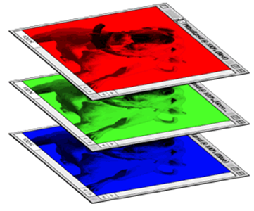
Color image: RGB 3 channels
1 | -1 | -1
-1 | 1 | -1
-1 | -1 | 1
-1 | 1 | -1
-1 | 1 | -1
-1 | 1 | -1
1 | -1 | -1
-1 | 1 | -1
-1 | -1 | 1
-1 | 1 | -1
-1 | 1 | -1
-1 | 1 | -1
1 | -1 | -1
-1 | 1 | -1
-1 | -1 | 1
-1 | 1 | -1
-1 | 1 | -1
-1 | 1 | -1
Filter 1
Filter 2
Color image
1 | 0 | 0 | 0 | 0 | 1
0 | 1 | 0 | 0 | 1 | 0
0 | 0 | 1 | 1 | 0 | 0
1 | 0 | 0 | 0 | 1 | 0
0 | 1 | 0 | 0 | 1 | 0
0 | 0 | 1 | 0 | 1 | 0
1 | 0 | 0 | 0 | 0 | 1
0 | 1 | 0 | 0 | 1 | 0
0 | 0 | 1 | 1 | 0 | 0
1 | 0 | 0 | 0 | 1 | 0
0 | 1 | 0 | 0 | 1 | 0
0 | 0 | 1 | 0 | 1 | 0
1 | 0 | 0 | 0 | 0 | 1
0 | 1 | 0 | 0 | 1 | 0
0 | 0 | 1 | 1 | 0 | 0
1 | 0 | 0 | 0 | 1 | 0
0 | 1 | 0 | 0 | 1 | 0
0 | 0 | 1 | 0 | 1 | 0

Slide 33
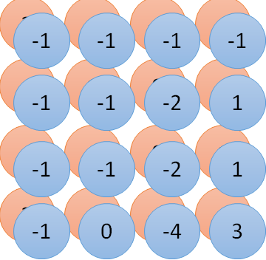
Convolution v.s. Fully Connected
1 | 0 | 0 | 0 | 0 | 1
0 | 1 | 0 | 0 | 1 | 0
0 | 0 | 1 | 1 | 0 | 0
1 | 0 | 0 | 0 | 1 | 0
0 | 1 | 0 | 0 | 1 | 0
0 | 0 | 1 | 0 | 1 | 0
1 | -1 | -1
-1 | 1 | -1
-1 | -1 | 1
-1 | 1 | -1
-1 | 1 | -1
-1 | 1 | -1
convolution
image
1 | 0 | 0 | 0 | 0 | 1
0 | 1 | 0 | 0 | 1 | 0
0 | 0 | 1 | 1 | 0 | 0
1 | 0 | 0 | 0 | 1 | 0
0 | 1 | 0 | 0 | 1 | 0
0 | 0 | 1 | 0 | 1 | 0
Fully-connected
……
……

Slide 34
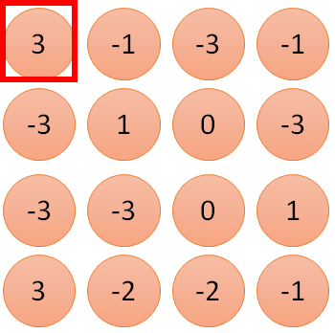
1 | -1 | -1
-1 | 1 | -1
-1 | -1 | 1
1
1
Filter 1
2
0
3
0
3
4:
0
1 | 0 | 0 | 0 | 0 | 1
0 | 1 | 0 | 0 | 1 | 0
0 | 0 | 1 | 1 | 0 | 0
1 | 0 | 0 | 0 | 1 | 0
0 | 1 | 0 | 0 | 1 | 0
0 | 0 | 1 | 0 | 1 | 0
…
0
8
1
9
0
10:
0
…
13
0
6 x 6 image
14
0
fewer parameters!
15
Only connect to 9 inputs, not fully connected
1
16
1
…

Slide 35
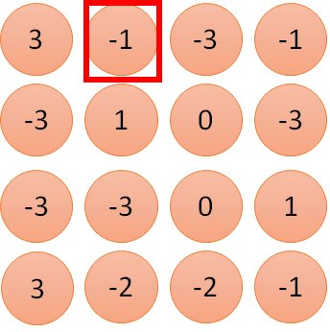
1 | -1 | -1
-1 | 1 | -1
-1 | -1 | 1
1:
1
Filter 1
2:
0
3:
0
3
4:
0
1 | 0 | 0 | 0 | 0 | 1
0 | 1 | 0 | 0 | 1 | 0
0 | 0 | 1 | 1 | 0 | 0
1 | 0 | 0 | 0 | 1 | 0
0 | 1 | 0 | 0 | 1 | 0
0 | 0 | 1 | 0 | 1 | 0
…
7:
0
8:
1
-1
9:
0
10:
0
…
13:
0
6 x 6 image
14:
0
Fewer parameters
15:
1
16:
1
Shared weights
Even fewer parameters
…

Slide 36


The whole CNN
cat dog ……
Convolution
Max Pooling
Can repeat many times
Fully Connected Feedforward network
Convolution
Max Pooling
Flattened

Slide 37
Max Pooling
1 | -1 | -1
-1 | 1 | -1
-1 | -1 | 1
-1 | 1 | -1
-1 | 1 | -1
-1 | 1 | -1
Filter 1
Filter 2
3
-1
-3
-1
-1
-1
-1
-1
-3
1
0
-3
-1
-1
-2
1
-3
-3
0
1
-1
-1
-2
1
3
-2
-2
-1
-1
0
-4
3

Slide 38


Why Pooling
Subsampling pixels will not change the object
bird
bird
Subsampling
We can subsample the pixels to make image smaller
fewer parameters to characterize the image

Slide 39
A CNN compresses a fully connected network in two ways:
Reducing number of connections
Shared weights on the edges
Max pooling further reduces the complexity

Slide 40
Max Pooling
New image
but smaller
1 | 0 | 0 | 0 | 0 | 1
0 | 1 | 0 | 0 | 1 | 0
0 | 0 | 1 | 1 | 0 | 0
1 | 0 | 0 | 0 | 1 | 0
0 | 1 | 0 | 0 | 1 | 0
0 | 0 | 1 | 0 | 1 | 0
Conv
3
0
-1
1
Max
Pooling
3
1
0
3
2 x 2 image
6 x 6 image
Each filter
produces a channel

Slide 41
The whole CNN
3
0
-1
1
Convolution
3
1
0
3
Max Pooling
Can repeat many times
A new image
Convolution
Smaller than the original image
The number of channels is the number of filters
Max Pooling

Slide 42
The whole CNN
cat dog ……
Convolution
Max Pooling
Fully Connected Feedforward network
A new image
Convolution
Max Pooling
Flattened
A new image

Slide 43
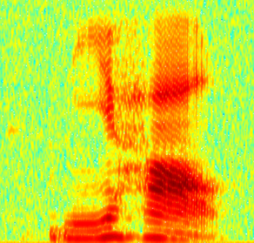
CNN in speech recognition
The filters move in the frequency direction.
CNN
Frequency
Image
Time
Spectrogram

Slide 44
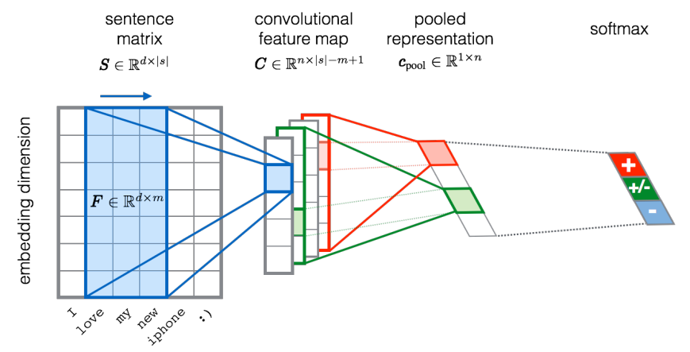
CNN in text classification
?
Source of image: http://citeseerx.ist.psu.edu/viewdoc/download?doi=10.1.1.703.6858&rep=rep1&type=pdf

Slide 45
Case Study - AlexNet
[Krizhevsky et al. 2012]

Slide 46
Case Study - AlexNet
[Krizhevsky et al. 2012]
Input: 227x227x3 images
First layer (CONV1): 96 11x11 filters applied at stride 4
Q: what is the output volume size?
Hint: (227-11)/4+1 = 55
Output volume [55x55x96]
Q: What is the total number of parameters in this layer?
Parameters: (11*11*3)*96 = 35K

Slide 47
Case Study - AlexNet
[Krizhevsky et al. 2012]
Input: 227x227x3 images
Input: 227x227x3 images
After CONV1: 55x55x96
Second layer (POOL1): 3x3 filters applied at stride 2
Q: what is the output volume size? Hint: (55-3)/2+1 = 27
Output volume: 27x27x96
Q: what is the number of parameters in this layer?
Parameters: 0!

Slide 48
Case Study - AlexNet
[Krizhevsky et al. 2012]
Full (simplified) AlexNet architecture:
[227x227x3] INPUT
[55x55x96] CONV1: 96 11x11 filters at stride 4, pad 0
[27x27x96] MAX POOL1: 3x3 filters at stride 2
[27x27x96] NORM1: Normalization layer [27x27x256]
CONV2: 256 5x5 filters at stride 1, pad 2 [13x13x256]
MAX POOL2: 3x3 filters at stride 2 [13x13x256]
NORM2: Normalization layer
[13x13x384] CONV3: 384 3x3 filters at stride 1, pad 1
[13x13x384] CONV4: 384 3x3 filters at stride 1, pad 1
[13x13x256] CONV5: 256 3x3 filters at stride 1, pad 1
[6x6x256] MAX POOL3: 3x3 filters at stride 2
[4096] FC6: 4096 neurons
[4096] FC7: 4096 neurons
[1000] FC8: 1000 neurons (class scores)
More Details:
- first use of ReLU
used Norm layers (not common anymore)
heavy data augmentation
dropout 0.5
batch size 128
SGD Momentum 0.9
Learning rate 1e-2, reduced by 10 manually when val accuracy plateaus
L2 weight decay 5e-4
7 CNN ensemble: 18.2% -> 15.4%

Slide 49
Thank you

